Slide 1
Summary
Problem/Hypothesis
How
High-level conclusion

Slide 2
Background
Other studies on gentrification
Stage Theory
People, Policy, Place
Model neighborhoods

Slide 3
Emmy
our approach
construct an accurate snapshot of NYC neighborhoods
explore growth trends by neighborhood
develop a method to rank investment worthiness
evaluate the effectiveness of each method

Slide 4
Emmy
the variables
people
place
policy
income & crime
sales & development
opportunity zone
IRS NYPD
DOF DOB
NY ESD

Slide 5
Michana
Data Exploration
Income – IRS
- year,s
Sales –
Dev
A

Slide 6
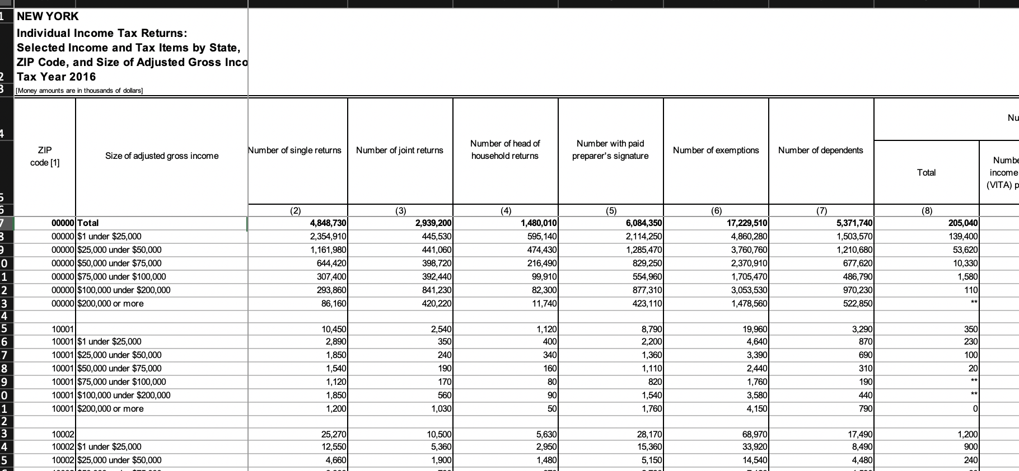
Crime - Michana
Data Clean Up
Before and After
Tell the transformation story

Slide 7
Emmy
our data -> sales
80 spreadsheets
1 SQL database
5 csv files
Combined sales dataframe
Calculated sales metrics
JUNCTION TABLE

Slide 8
Emmy
our data -> development
OPEN DATA API
Dataframe
Dataframe with Neighborhood
Calculated development metrics
JUNCTION TABLE

Slide 9
JC - Income
Data Clean Up
Before and After
Tell the transformation story

Slide 10
???
Coding for Model

Slide 11
All
Dashboard

Slide 12
All – but one slide
Hypothesis
Conclusion

Slide 13
JC
Limitations
Recommendations

Slide 14
Q&A

